Slide 1
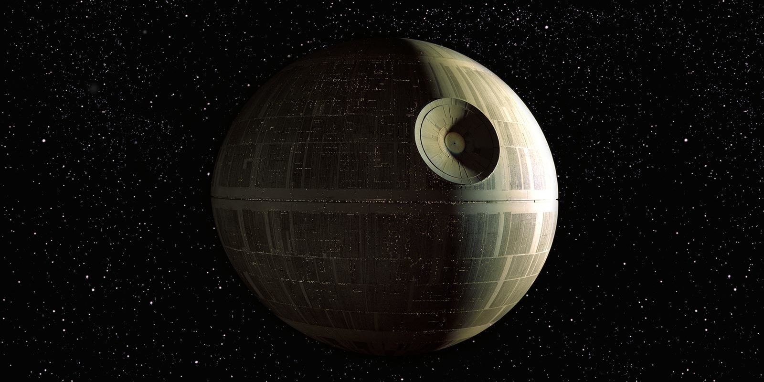
For The Glory of the Empire
Group 14

